Slide 1
Lecture 3
DOM

Slide 2
Comments
Comments in HTML tell the browser to ignore the specified set of HTML tags.
Syntax> <!-- Every thing inside these arrows will be ignored -->

Slide 3
COMMENTS
<div> <!--
<section>This is a section</section> <b>This is a bold tag</b> --> <input type=“text” /> </div> <aside>This is a aside tag</section>

Slide 4
Comments
Comments allow us to retain the code for future reference without being executed in browser. Advantages of Comments:
Comments facilitate understanding.
Commenting can also assist with hotfixes or quick fixes
Comments help speed up the development process.

Slide 5
AUDIO AN VIDEO TAGS
<audio controls> <source src=“my-audio.mp3”></source>
<source src=“new-audio.aac”></source>
</audio>
<video controls> <source src=“my-audio.mp3”></source>
<source src=“new-audio.aac”></source>
</ video >

Slide 6
Understanding DOM
DOM (document object model) is a tree of all HTML elements that structure the whole document.
Example> (A simple DOM)
<html>
<body> <h1>This is a heading</h1> </body> </html

Slide 7

Understanding DOM

Slide 8
Understanding dom
DOM allows us to understand and manipulate the HTML elements in a meaningful way.
The HTML DOM is a standard for how to get, change, add, or delete HTML elements.

Slide 9
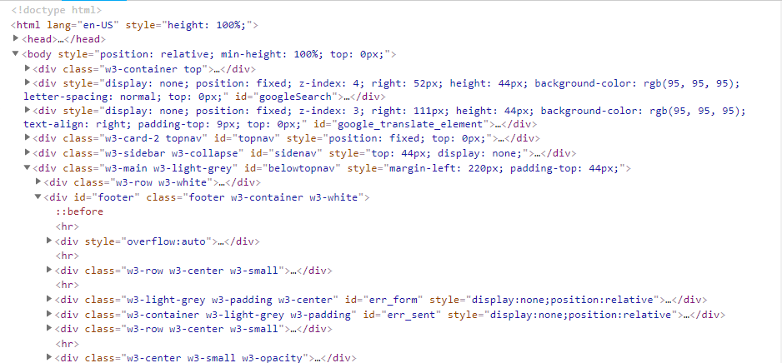
Understanding dom

Slide 10
Understanding dom
The DOM defines:
The HTML elements as objects
The properties of all HTML elements
The methods to access all HTML elements
The events for all HTML elements

Slide 11
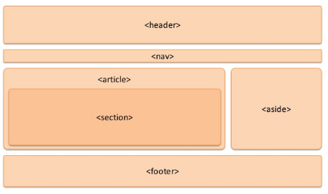
Understanding Site layout

Slide 12
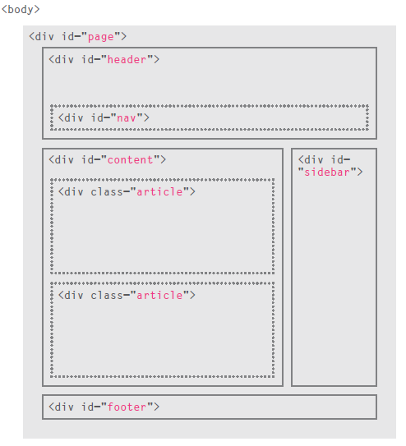

Slide 13
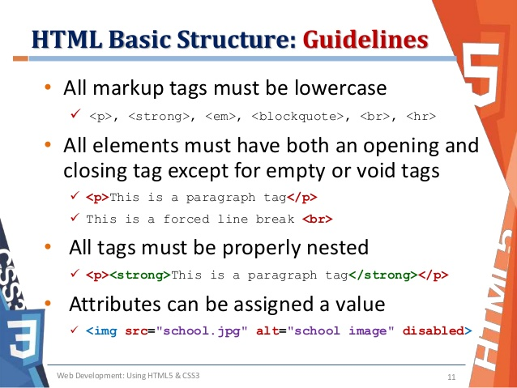

Slide 14
Classes
Class is an attribute which is used to group a set of HTML elements. This helps us in manipulating all the elements at once.
Example>
<input class = “myElement” /> <div> This is my div </div> <span class = “myElement”> This is a span tag </span> <section class = “myElement”></section>

Slide 15
Classes
<input class = “myElement” /> <div> This is my div </div> <span class = “myElement”> This is a span tag </span> <section class = “myElement”></section>
class = “myElement”
<input class = “myElement” /> <span class = “myElement”>
<section class = “myElement”>

Slide 16
ID
id is an attribute used to uniquely identify an HTML element in a web document. Example>
<input id=“nameBox” type=“text” /> <span id=“passwordBox”></span> <div id=“addressBox”></div>

Slide 17
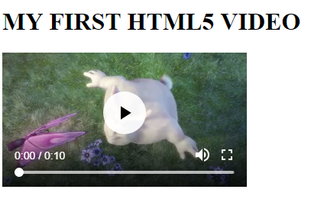
Today’s Assignment
The video element should have an ID and we should be able to access the HTML element in the
developer console through ID.

